Slide 1



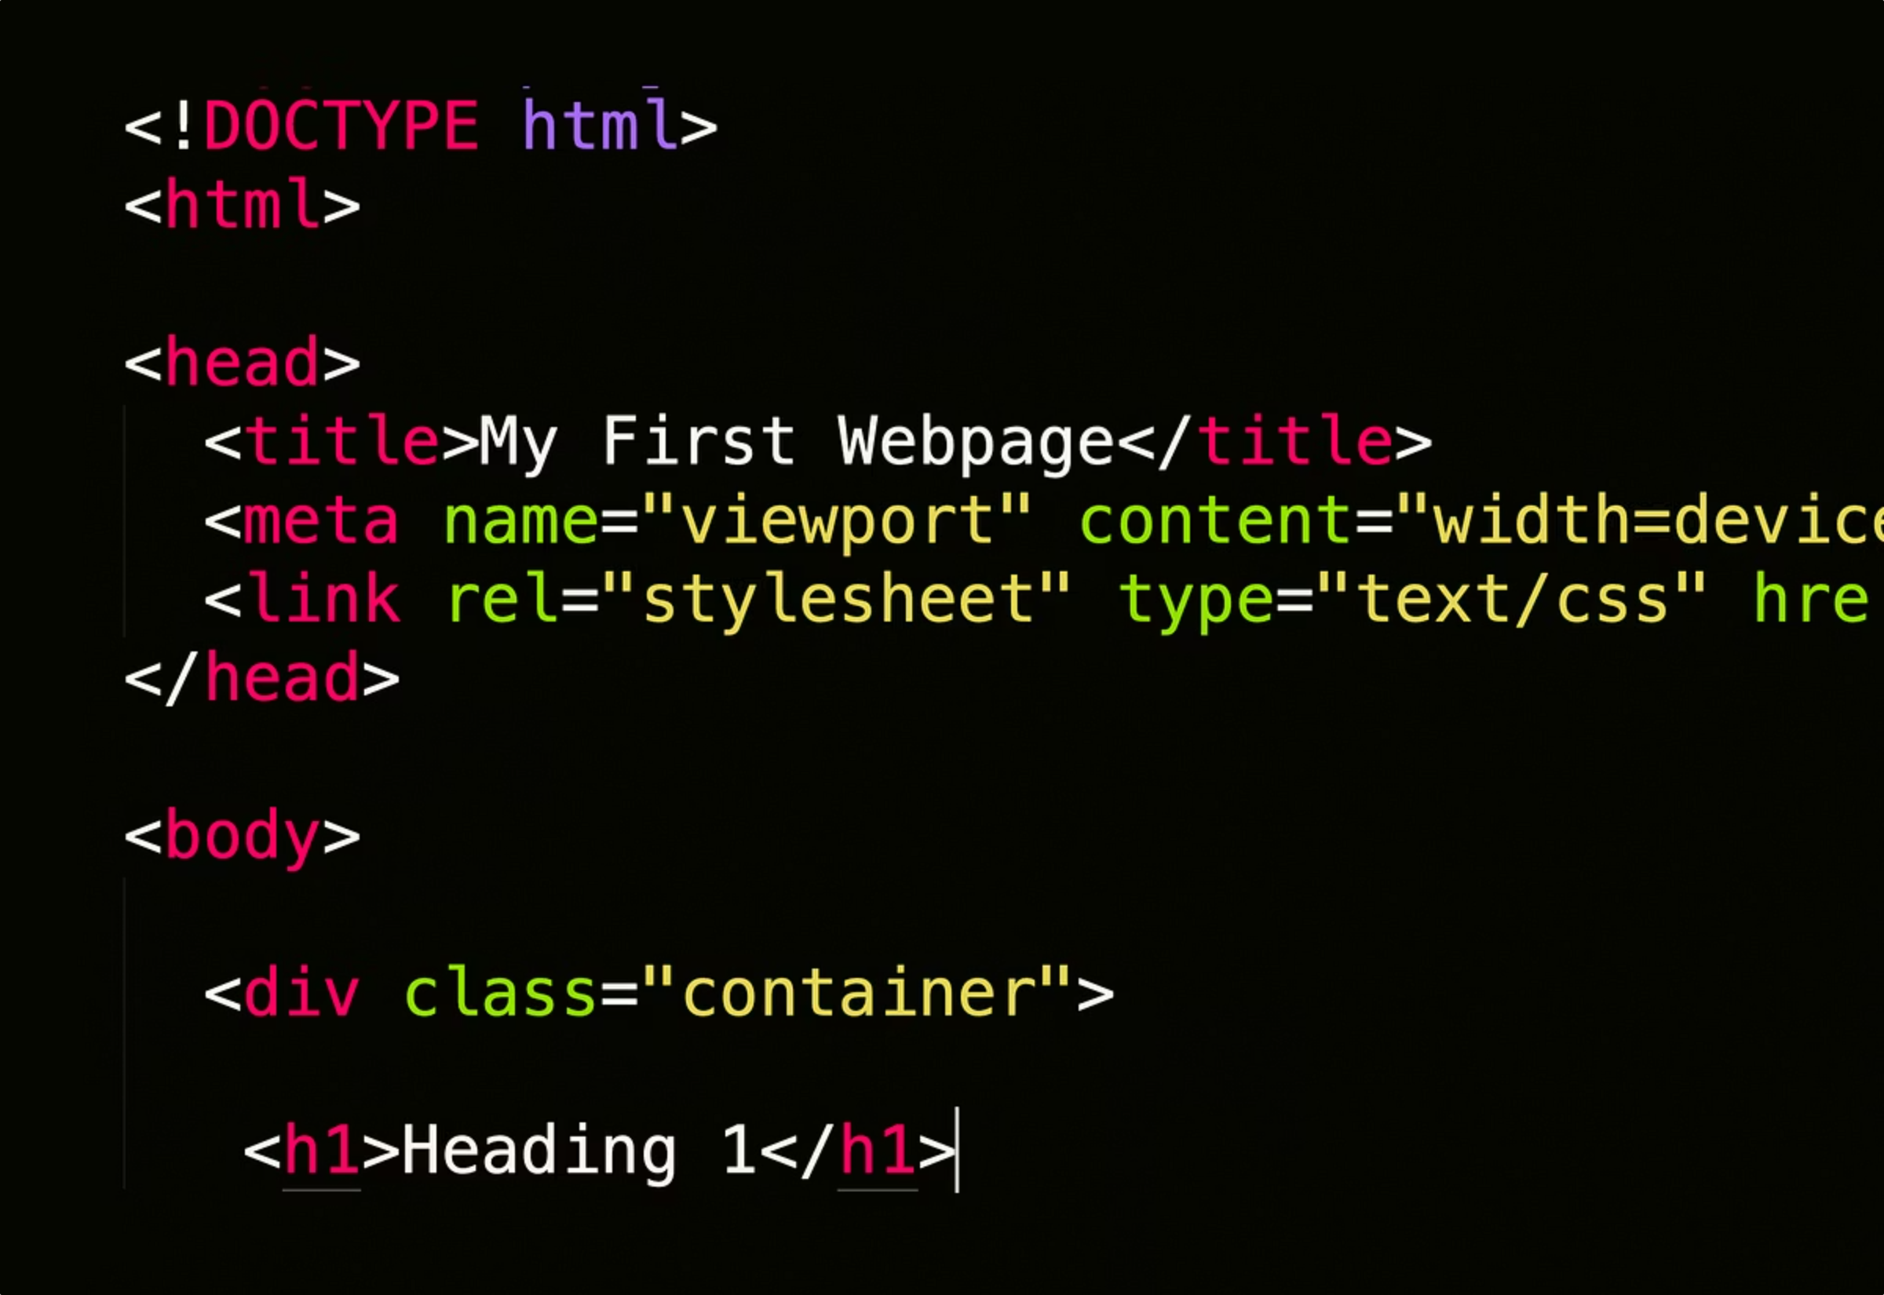

Understanding HTML: The Foundation of the Web
Welcome to our introductory guide on HTML! This presentation will cover the fundamentals of HyperText Markup Language, the essential building block of all web pages. Get ready to learn how to structure content for the internet.
by Goodness Adewuyi

Slide 2

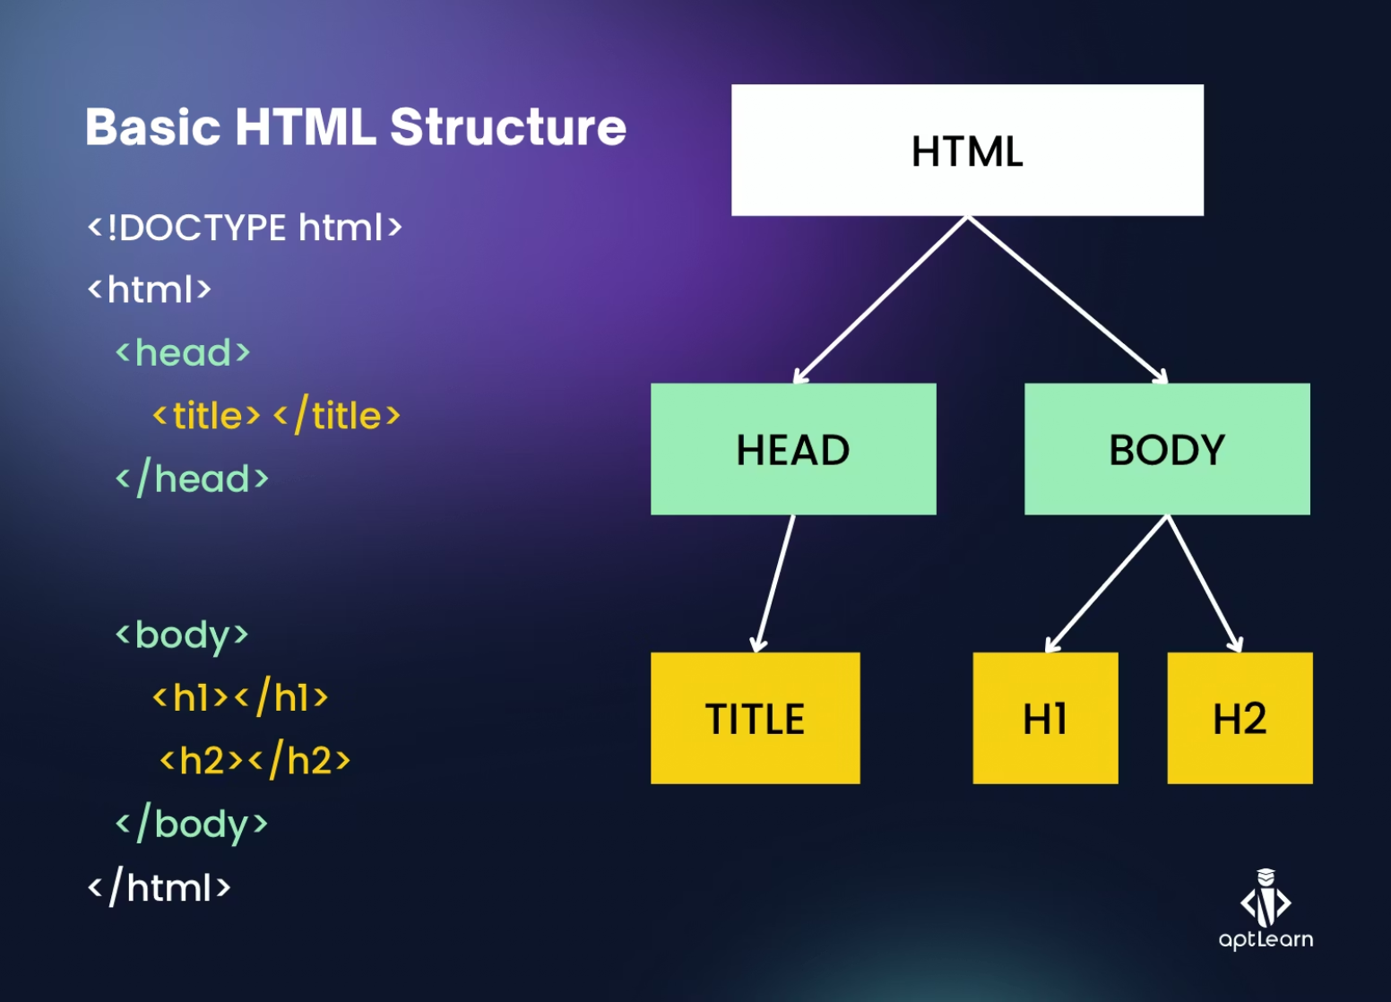
Basic HTML Page Structure
Every HTML document follows a standard structure.
The !DOCTYPE declaration defines the document type.
The html element is the root of the page.
The head contains metadata, and the body holds visible content.

Slide 3
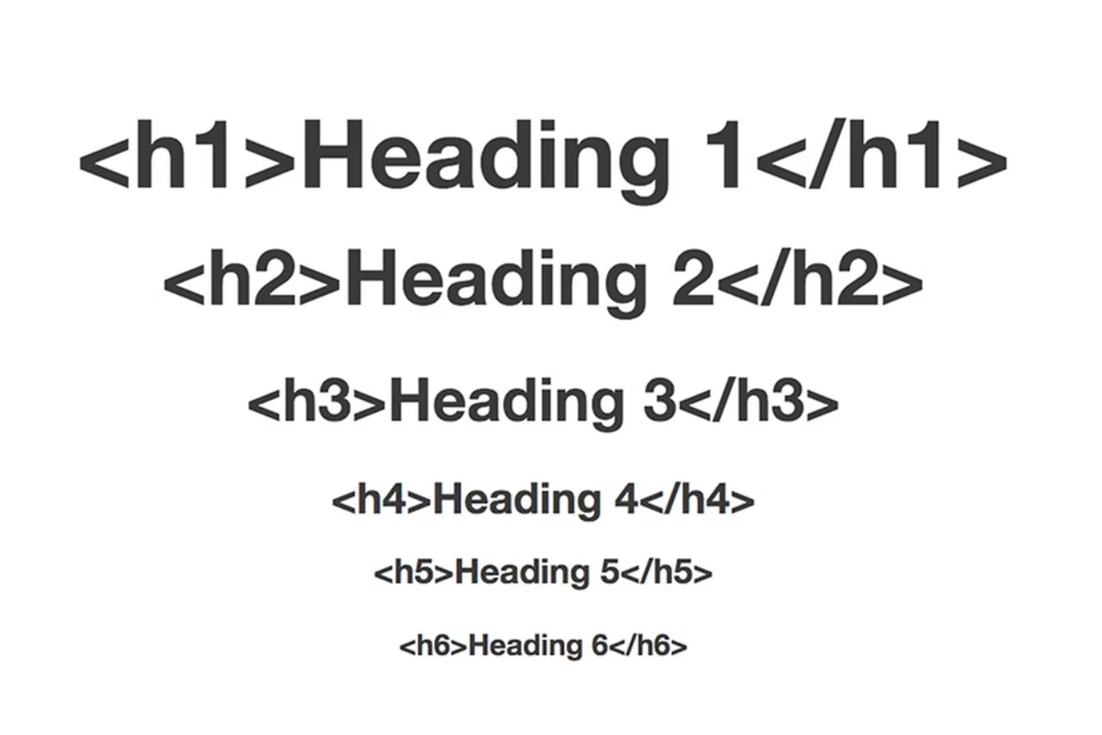
Headings and Paragraphs
Headings
Use H1 to H6 for titles.
H1 is the most important, H6 the least.
Paragraphs
Use P tags for blocks of text.
They create new lines automatically.

Slide 4
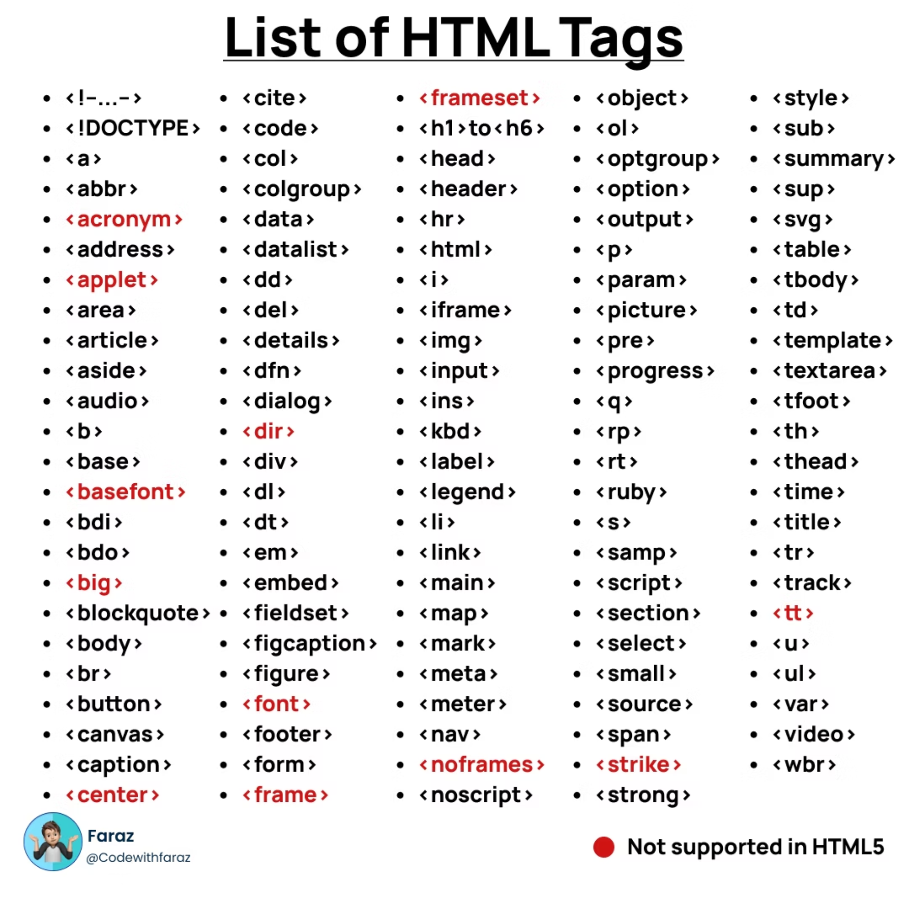


Links and Images
Hyperlinks
A tags create clickable links.
Example: <a href="https://example.com">Visit Site</a>
Images
IMG tags embed pictures.
src points to the image file.
alt provides alternative text for accessibility.
Example: <img src="pic.jpg" alt="Description">

Slide 5
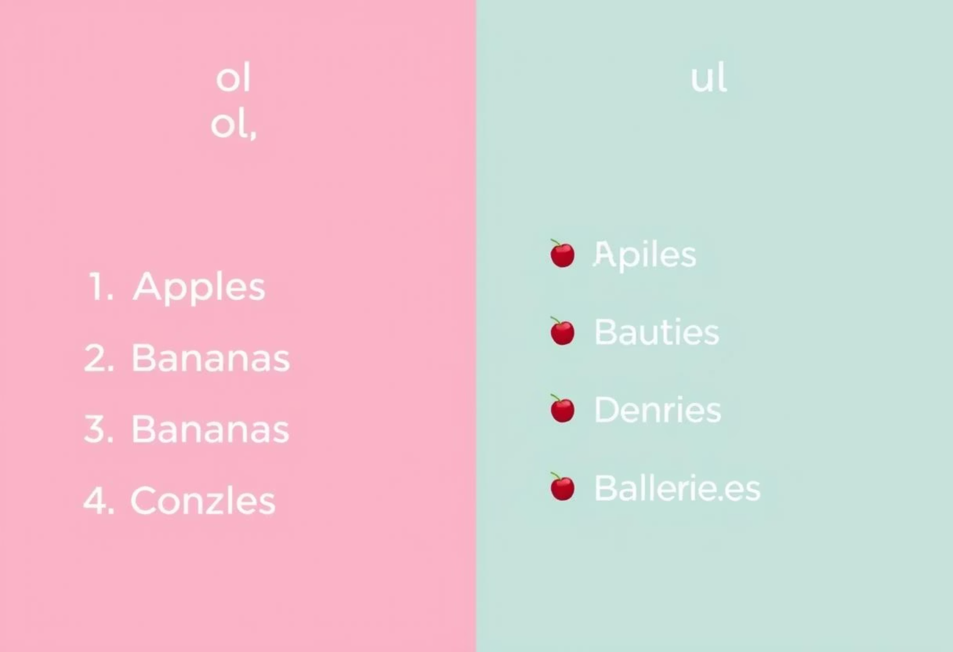
Creating Lists
1
Ordered Lists
OL tags create numbered lists.
LI tags define each list item.
They are great for step-by-step instructions.
2
Unordered Lists
UL tags create bulleted lists.
LI tags define each list item.
Perfect for non-sequential information.

Slide 6

Formatting Text
1
Bold Text
<b>
2
Italic Text
<i>
3
Line Breaks
<br>

Slide 7
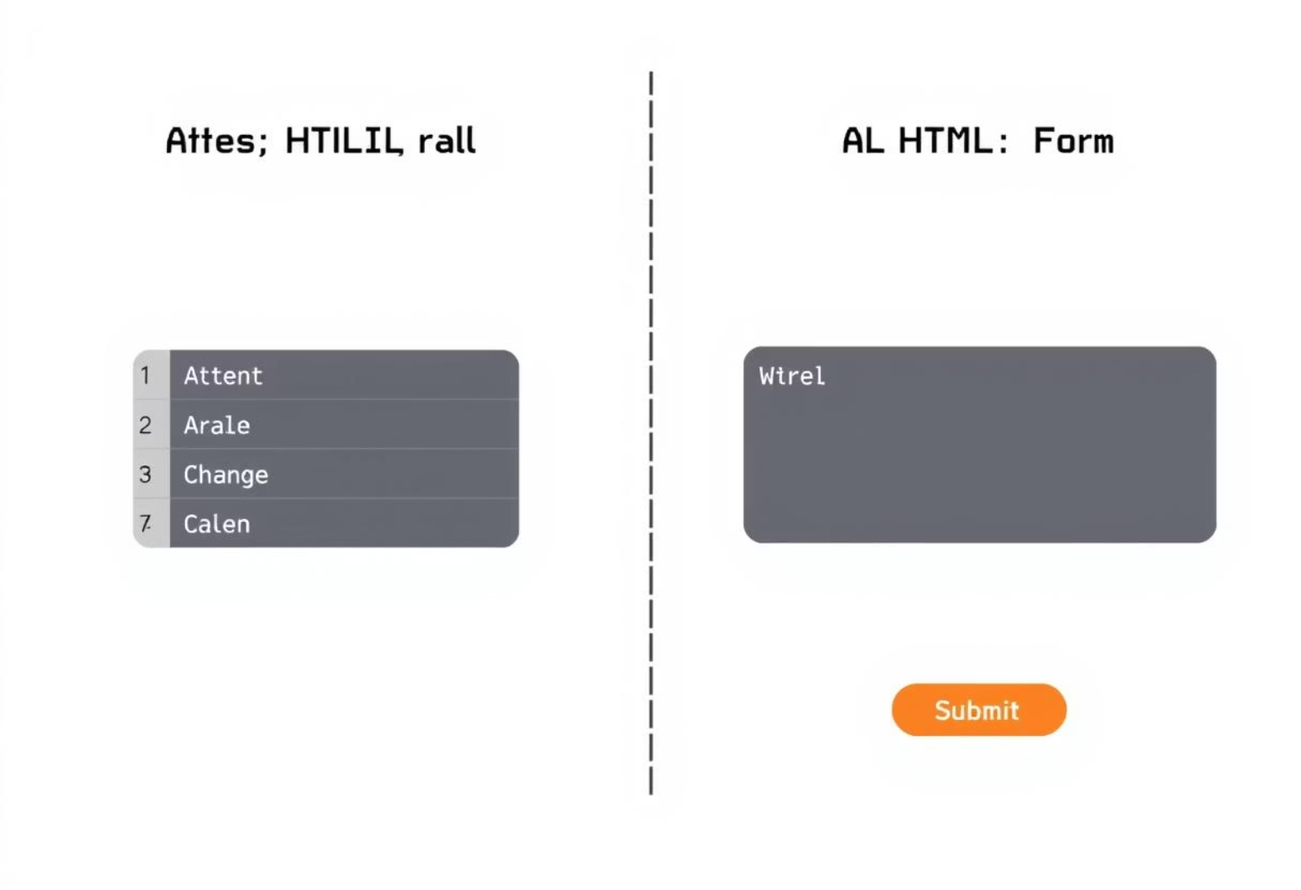
Tables and Forms: A Brief Introduction
Tables
Table organises data in rows and columns.
TR for rows, TD for data cells, TH for headers.
Forms
Form collects user input.
Input fields gather text, numbers, etc.
Button submits the form data.

Slide 8

Final Tips and Recap
1
Close Your Tags
2
Indent for Readability
3
Use Inspect Tool

